Slide 1
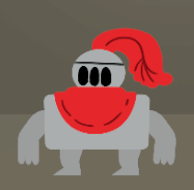
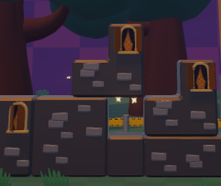
Tetrimination Pitch

Slide 2


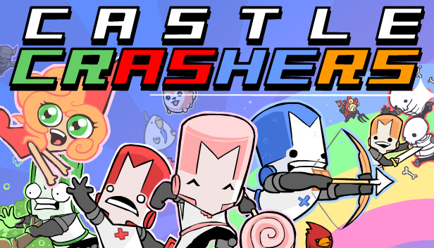
Why?

Slide 3
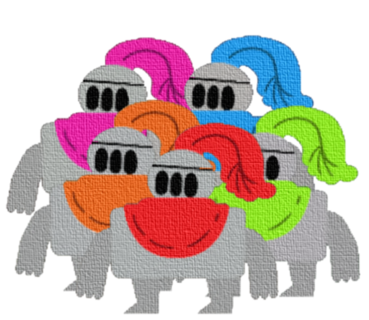
The Team
Bull Andrés
De Weert Erik
Lefebre Elias
Bongaerts Yorick
Olbrechts Baue

Slide 4
Trailer
Add trailer video

Slide 5
Game Overview
Party game
Tetris like
Points system
Platforming
Strategy
Multiple Rounds

Slide 6
Player Objective
Goal: Getting the most points
Overlord
Blocking players inside
Crush players
Climber
Reaching new heights
Climbing to the top
Killing players
Make overlord build too high

Slide 7

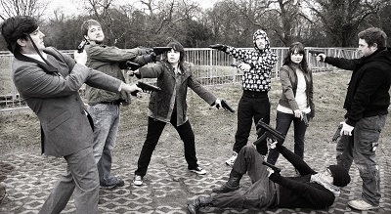
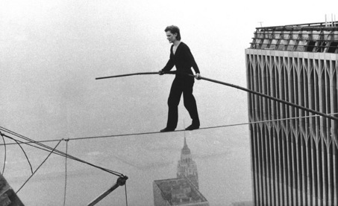
Design Pillars
Cunning: Work together or not?
Take-That!: Backstabbing advised
Balancing: Keep track of abilities and use them wisely
VS
Notes:
Zie design pillars in GDD

Slide 8





Unique Selling Points
Many ways to play
Tricking enemies
Resource management
Short party game
This Photo by Unknown Author is licensed under CC BY-SA
Notes:
Met many ways to play bedoel ik dan: FFA, 1v3, backstabbing
Resource management doelt op ability timers en ladders die kunnen breken

Slide 9
Aimed at Xbox One
Party context

Slide 10


Slide 11


